Slide 1
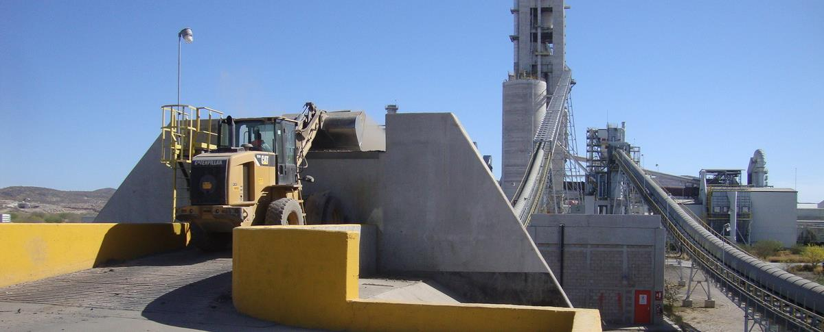
AFR Feed Systems
SPREAD Course 2016, Settat, Sorin Petrescu - Geocycle
© 2015 Holcim Technology Ltd

Slide 2
Content
Elements of solid AF feed systems
Storage
Extraction and Dosing of Solid AFR
Transport
Feed chute / Airlock
AF Feed System Overview
Fine Solid AFR Handling
Coarse Solid AFR Handling
Liquid AFR Handling
Sludge Handling
Design Safety of AFR Feed Systems

Slide 3
Learning Objectives
To know the key handling equipment for AFR
How it works
Typical issues and low cost problem solving/optimization
To know the installations – low cost systems to start and standard facilities for higher AFR volumes
To see new developments in AFR handling and feeding

Slide 4
Storage
Loader operated storage
Bridge Crane operated Storage Hall
Silo Storage
Stacker/Reclaimer Box

Slide 5
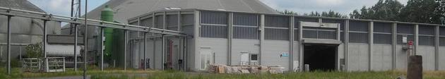
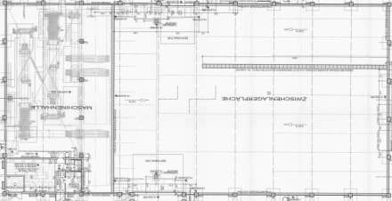
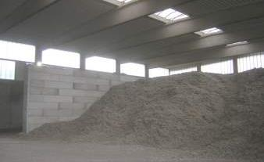
Loader operated Storage Hall
Example Fluff Handling, Lägerdorf
Feed Hopper
Storage
Feed Hopper
Storage
Feed Hopper
Total 3600 m3

Slide 6
Loader operated Storage Hall
Preferably storage pile and hoppers located in the same building (avoid outside spillage from loader transport)
Advantages:
Flexibility
Relatively cheap building
No limitations in size and feed rate
Drawbacks:
High operating costs for front end loader and operator
Depending on set up, first in - first out is not possible
Mobile equipment operating in explosive zones when handling fine combustible material

Slide 7
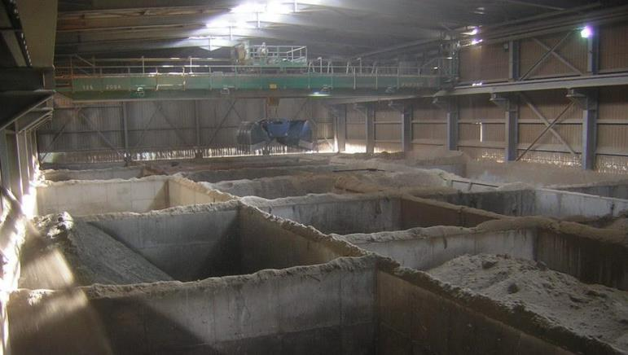
Bridge Crane Operated Storage Hall
Advantages
Big storage height → small footprint
Flexibility
Drawbacks
Dust accumulations
Ventilation in case of vapours
Dead corners
(First in - last out)
Expensive building and equipment
Feeding without crane impossible
Limited capacity (~200m3/h)

Slide 8
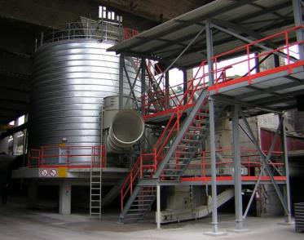
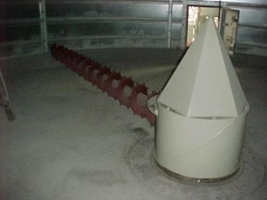
Silo Storage
Only flat bottom silos with planetary screw
extraction acceptable - no silo cones!
Planetary screw must be overdesigned
Screw teeth must be wear-protected (e.g. tungsten carbide coating)
Big issue if extraction screw fails (silo full of material)
Max. particle size < 100mm, only recommended for fine solid AF
Silo Diameter: > 5m to prevent bridging between silo-wall and centre hood
Certain homogenization effect
Notes:
up to 2000 m3, silos installed in France 700-800m3. Mainly chip size limited. If screw is blocked – high effort for emptying/repair. Planning important.

Slide 9
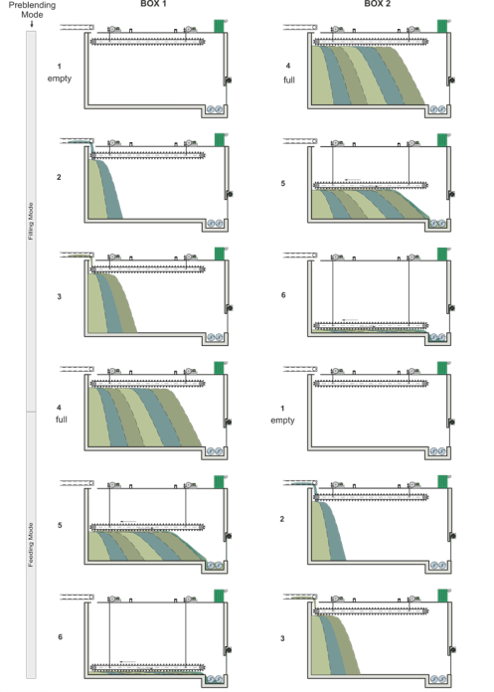
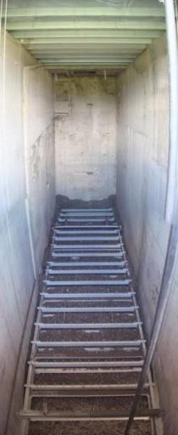
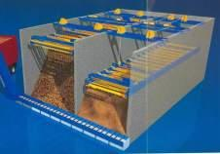
Alternative to Silos: Stacker/Reclaimer Box
Suppliers: Vecoplan (inventor), FLS (copy), DiMatteo (copy)
Chips sizes < 80 mm (no long strips), only for fine solid AF
Fully enclosed design / dedusting required
Explosion protection: same requirements as silos
Homogenization effect
2 boxes per AFR preferred
Video Vecobox Reclaimer box in action
Notes:
one Vecobox has roughly 900 m3 active volume

Slide 10
Extraction and Dosing of Solid AFR

Slide 11
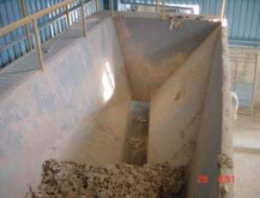
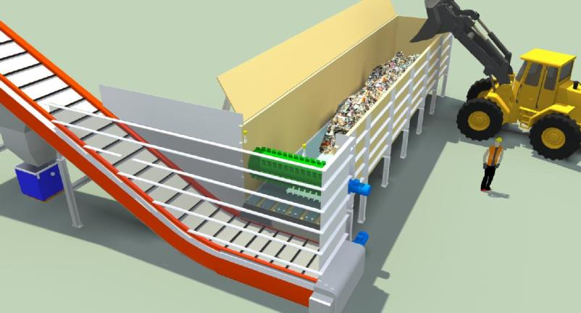
AFR and inclined walls does not work!
Inclined hopper walls and
narrow outlet lead to
material blockages
Hopper with vertical walls and activated floor extraction

Slide 12
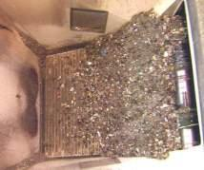
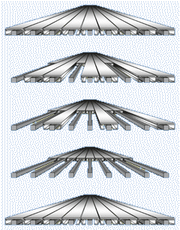
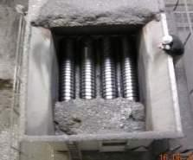
Extraction: Vertical Walls & Activated Floor
Walking Floor
Apron Feeder
Screw Floor

Slide 13
Dosing of Coarse & Fine Solid AF
Video: Westeria Dosing Drum
Always in 3 Steps!
a) Fine solid AF
Side View
Extraction Activated bottom
1
1
2
Volumetric Dosing
2
3
a) Fine solid AF: Dosing Screws
b) Coarse solid AF
Belt Scale (not recommended)
Front View
Belt Weigh Feeder (recommended)
b) Coarse solid AF: Dosing drum on WF exit and/or Stripping wheel on belt or Shaftless dosing screw
Feed Hopper
with Walking Floor
1
Dosing drum
1
Stripping wheel
2
2
Gravimetric Dosing Belt Weigh Feeder
3
3
Variable Speed Belt, inclined 18° (cleated <35°)
Belt Scale (not recommended)
Belt Weigh Feeder (recommended)

Slide 14
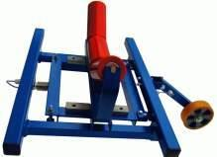
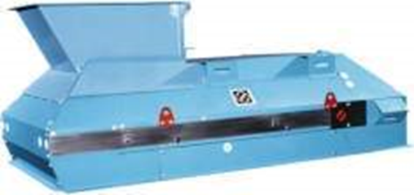
Belt Scale / Belt Weigh Feeder
Belt scale: not recommended for final dosing (accuracy), especially on inclined belts. → independent weigh feeder needed
Belt Weigh Feeder:
Controls the speed of the volumetric dosing device
Can absorb bed height fluctuations by adjusting belt speed
Belt tension control integrated
Only install fully enclosed versions

Slide 15
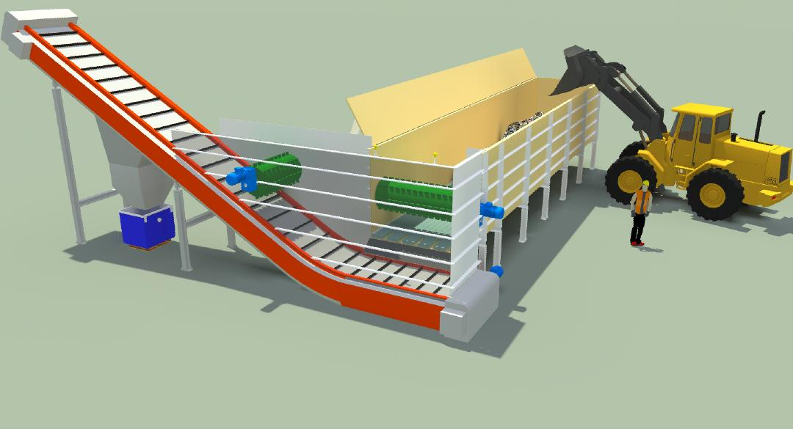
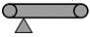
Walking Floor Dosing Solution
Chain belt conveyor VFD controlled by weigh feeder, belt inclination typically 30deg
Truck or loader discharge must be possible over the whole hopper side and not from the top end.
Continuous level sensors
Co-Rotating Dosing Drum for 90% perfect volumetric flow
Belt Weigh Feeder
Spillage collection of chain belt conveyor
Walking floor VFD controlled by continuous level sensors located above discharge
Counter-Rotating Drum for 100% perfect volumetric flow, not needed if Multiflex is at PH-tower located for final dosing

Slide 16
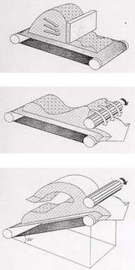
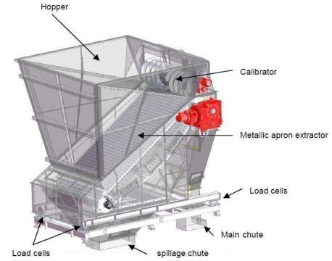
The Inclined Apron Feeder is the HTEC standard hopper for coarse solids in combination with autom. overhead crane
It combines the two first dosing steps in one unit
Hopper 5-15 m3
Counter-rotating stripping roll
Apron Conveyor, width 1.5 – 3 m
Load cells for Filling degree detection
Notes:
Loss in weight dosing with ATS Feeder is possible if:
- Enclosed building (no wind influence)
- Filling to Discharge Time Ratio > 9 : 1 ( automatic crane feeding)

Slide 17
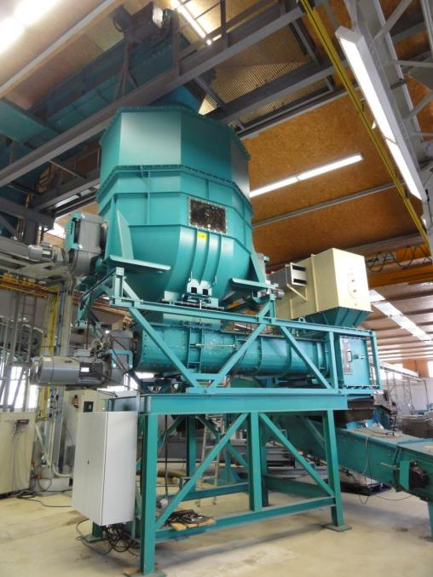
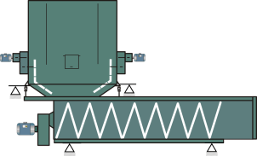
The Schenck Multiflex is a fully integrated screw weigh feeder suited for most fine & coarse AFR
Integrated system
Extraction, volumetric and gravimetric dosing in one unit
Pre-dosing bin (up to 25m3) on load cells with activation arms
Screw weigh feeder for fine and many types of coarse AFR
Shaftless screws (2x500mm) on load cells
Best demonstrated dosing accuracy
Max. feed rate: 200 m3/h
For most materials: acts as airlock if bin is sufficiently filled with material
Fully enclosed design
Fully explosion proof design available
Many references within Holcim
Notes:
Screw weigh feeder for fine and coarse AFR (can handle strips up to 1000 mm)
Pre-dosing bin (up to 9.5 m3) with a discharge aid
Shaftless screw (800 mm) on load cells
Best demonstrated dosing accuracy
Acts as airlock if bin is sufficiently filled with material
Fully enclosed design
Pressure-resistant design available
Dosing directly at the feed point possible
References CP (Romania) and BE (Bulgaria)
New HGRS Standard Weigh Feeder

Slide 18
Transport
Belt Conveyor
Sicon
Vecobelt
Through Chain Conveyor
Pneumatic

Slide 19
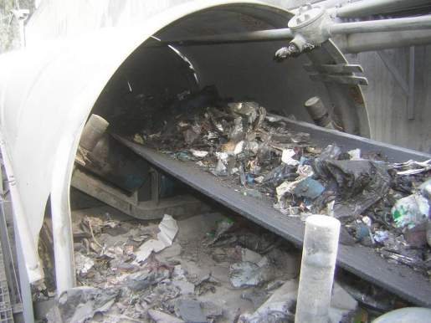
The Belt Conveyor is the most versatile transport system. However, never undersize it!
Oversize your Belt Conveyor!
Minimum Belt Width = 1000 mm

Slide 20
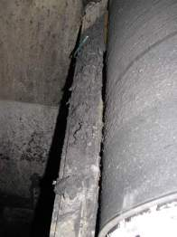
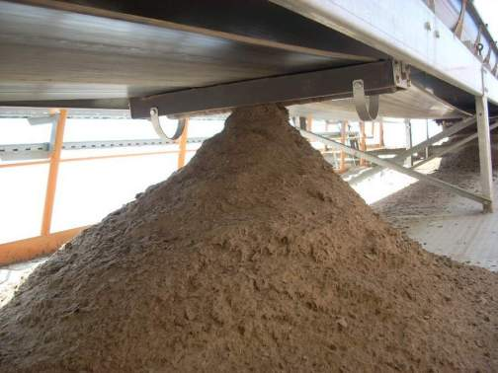
What is wrong here?

Slide 21
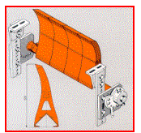
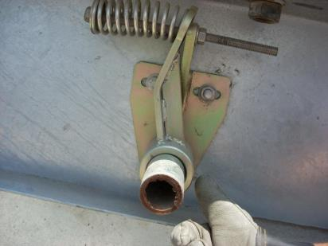
Belt Cleaner – Design Criteria
Minimum requirement for conveyor belt cleaning: dual belt cleaning system, consisting of primary and secondary belt cleaners
Regular maintenance!
Primary cleaner
Secondary cleaner
Tertiary
Cleaner
Fig. 1: Correct position of the primary – Installed at three (3) o'clock position – and secondary belt cleaners
Fig. 2: Segmented primary scraper plates (plastic)
Fig. 3: Primary cleaner – keep contact area constant

Slide 22
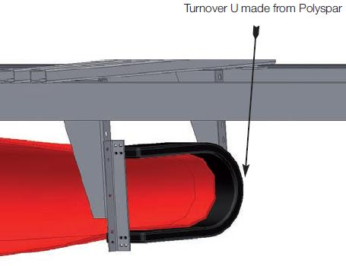
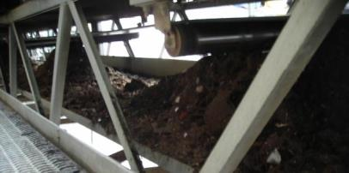
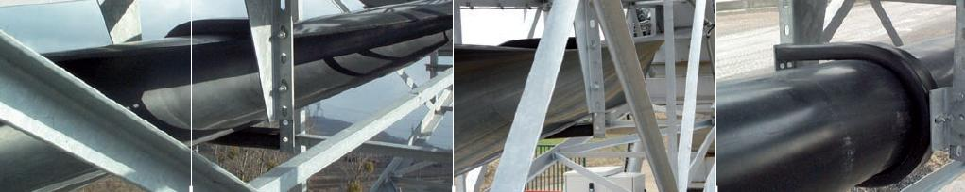
Clean return belt solution - Belt turning
Simple to add on each “normal” return belt
Low cost improvement ~5’000€
Coarse AFR reference: Holcim EC
Zero spillage after turning below the return idler

Slide 23
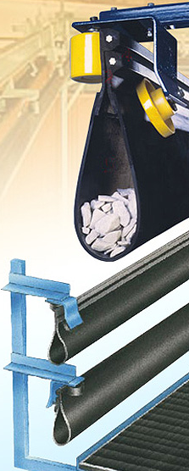
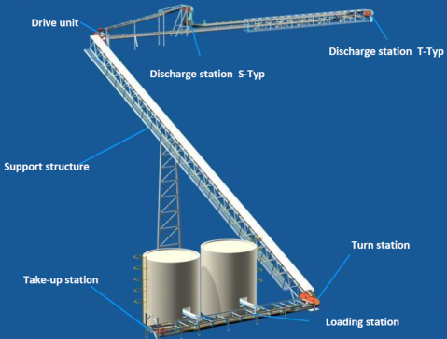
ContiTech - Sicon
Completely enclosed conveying system (carrying and return belt)
Extremely flexible routing possible
Horizontal curves: up to 180° turns with 1m radius (no transfer points)
Vertical curves: 40/60m radius
Max. inclination for AFR: 30°
Steel structure can be produced locally
Belt speed relatively high for maximum feedrates (2.5m/s for 250m3/h)

Slide 24
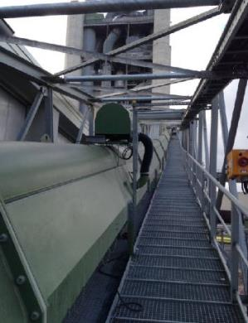
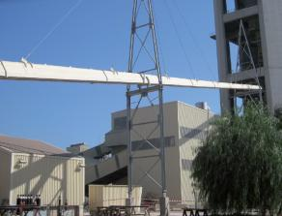
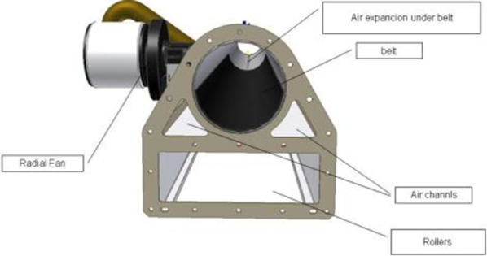
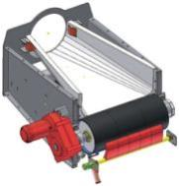
Vecobelt
Supplier Vecoplan
No carrying idlers, belt is gliding on an “air pillow” in a “pipe”.
Fully enclosed upper deck.
No maintenance sidewalk required, but easy to add if plant desired.
Higher belt speeds possible, allowing smaller belt widths.
Return belt open like ordinary belt
Vertical curves very limited.
Holcim reference: LD to feed very coarse AF to step combusting chamber
Not Holcim
Lägerdorf plant

Slide 25
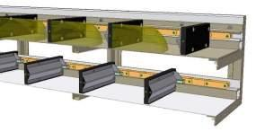
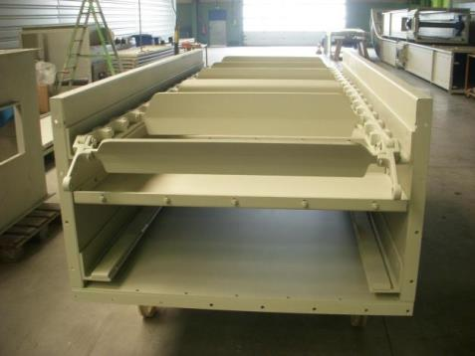
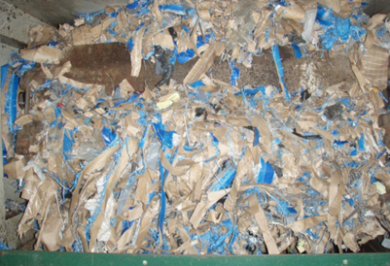
Through Chain Conveyor can also be used for “nice” coarse AFR and short conveying distance
Fully enclosed design
High Inclination (e.g. 65°) possible.
Chips size < 100 mm, no overlong foils or textiles. Generally only recommended for fine solid AF.
Maximum length (one piece) 60 m
Abrasive material is critical
Corrosion (-> dedusting) and wear problem !!

Slide 26
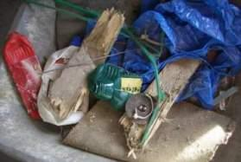
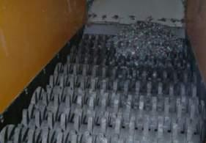
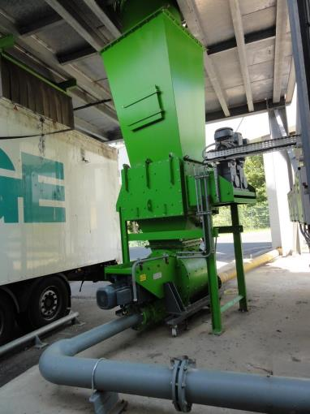
Pneumatic Transport – For Fine Solid AFR only
Oversized foreign bodies
can lead to blockages in
pneumatic transport lines
Installation of a or a lump breaker sieve before pneumatic transport highly recommended
Oversize material
Video: The Botha-Sizer

Slide 27
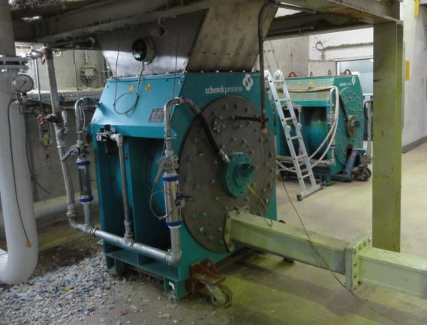
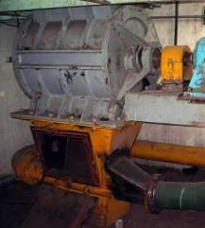
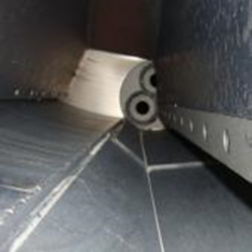
Rotary Valve
Drop-through vs. blow-through type:
Blow-through type especially preferred for sticky or build-up forming material, e.g. impregnated saw dust, animal meal etc. The whole compartment is blown out. Higher pressure drop.
Drop-through type is suited for very abrasive material e.g. dried sewage sludge or rice husks and very high feed rates (> 150 m3/h). Lower pressure drop.
Blow through type rotary valve
Drop through type rotary valve
Notes:
Principle: Transport air should accelerate and transport material. Leakage air through rotary valve hinders steady material flow by gravity (dosing fluctuation). Additionally the leakage air must go somewhere (dedusting above rotary valve required).

Slide 28
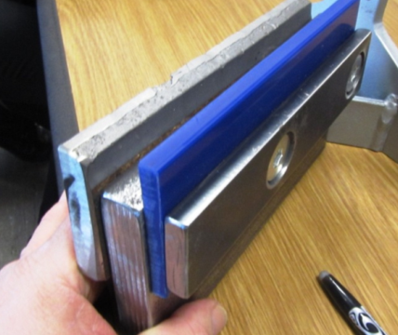
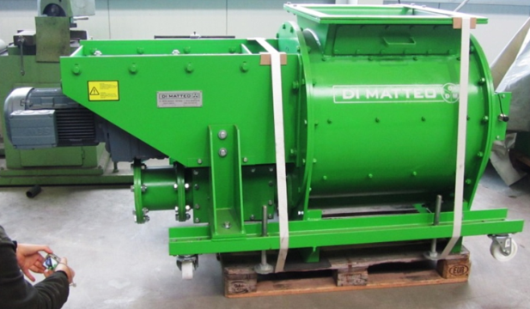
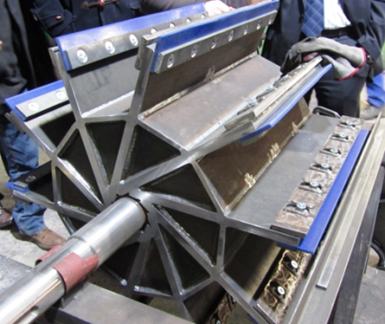
Rotary blow-through valve with combined soft and hard seal with positive experience
Disadvantages of normal rotary valves:
Hard (metal) seal: not very good sealing → leakage air
Soft (rubber) seal: fast wear → frequent maintenance (replacement) or leakage air
Combined seal:
Metal seal “cuts” large particles and prevents them from damaging soft seal
Hard and soft seal gap need to be re-adjusted regularly
~ 10 References in Holcim

Slide 29
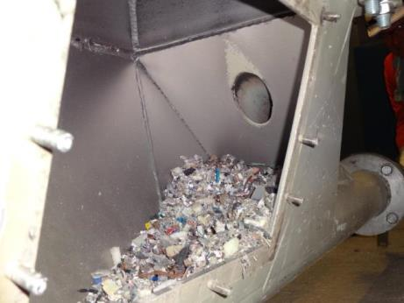




Rotary Valve
Issues with heavy material accumulation in injector
Positive experience with special “blowing shoe” in ex-Lafarge

Slide 30


Pneumatic Transport should be short and straight
Air:
Cooling < 20°C for sticky materials
Variable air flow (VFD) → possibility to find best air/fuel ratio and injection velocity
Injection speed approx. 30 - 45 m/s
Fuel/air ratio: 1 – 3 kg _{Fuel} / m3 _{Air}
Pipe:
Short and straight transport pipe
Constant cross section
Stainless pipe for sticky material
Wear protection by basalt or ceramics possible. ~1000 EUR/m for pipe and wear protection installed. Suppliers: Produr, Abresist, PA Technologies
(20°C, 1 bar)
Ceramic or Basalt wear protection for dried sewage sludge

Slide 31


Pneumatic Transport
Wear problems in bends
Especially in vertical bends as heavy material accumulates there.
Wear protection and/or drop-out box as solution, needs to be emptied periodically.
Notes:
option: heavy particle trap, requires emptying from time to time

Slide 32
Long Pneumatic Transport – Pros & Cons
Pros
Pneumatic transport direct to the burner (kiln or calciner) offers a low capex solution applicable to many solid alternative fuels
Often used as a “start up” system to enable a plant to achieve 10 - 20% fuel replacement, in several cases more than 30% replacement has been achieved.
Main burner systems require pneumatic injection through burner pipe
Injection point in calciner or kiln riser as the pipe can be relocated relatively easily
Due to enclosed nature of system there is limited house-keeping issues (spillage, fugitive dust) which reduces fire & explosion risk
Pneumatic systems can provide layout routes that may not be possible, or may be expensive with mechanical systems
Good forward planning with layout and equipment sizing could allow a pneumatic system to be upgraded to mechanical transport at a later date.
Acceptable reliability under optimum conditions, i.e. well designed system (layout, air volume) with well sized, clean solid AF
Cons
High Power Consumption – typical range for pneumatic conveying 0.03 – 0.06 kWh/t/m vs 0.006 – 0.01 kWh/t/m for tube belt conveyor. Example a tube conveyor transporting 20 tph SSW a distance of 200m with a vertical lift of 76m absorbs 35kW. A pneumatic conveying pipeline to deliver the same capacity over the same distance would require a 240m long pipeline with at least 4 bends and a compressor 7200 Nm3/hr and would absorb 130kW, the difference in power consumption would equate to approx Euro 50,000 per year
Generally poor reliability due to pipeline blockages with more difficult materials (over-size, irregular particle shape, abrasiveness, fibrous, foreign bodies, moisture, agglomerations ...). Experience in Lafarge suggests foreign bodies are by far the most problematic for reliability
Higher maintenance costs due to high wear, but this can be minimised by system design – minimising conveying distance by careful siting of the intake system and avoiding excessive pipeline velocity
Labour intensive stoppages – blockages can be frequent when AF fuel quality is less than optimum, with worn systems; often difficult to locate and clear blockages
Lack of flexibility; some materials cannot be transported by pneumatic conveying or may require extra preparation to transport them
Air volume into process (kiln) from transport system can be significant. Typically 5-8% of combustion requirements. Example 30% AF represents around 1% specific heat consumption. Although, air is often used at the injection point with mechanical systems to provide sufficient material distribution. In this case 20-30% less air would be required due to the lower air pressure for the short pipe
.
Notes:
option: heavy particle trap, requires emptying from time to time

Slide 33
Long Pneumatic Transport – Recommendations (1)
Material Properties for Pneumatic Conveying
Types of material conveyed –Wood chips, animal meal, plastics, dry sewage sludge, rice husk, coffee husk, seeds, construction and demolition waste, tyre fluff and any other finely shredded fuel.
Material size – generally combustion requirements are more stringent than for pneumatic transport.- finely shredded fuel < 50mm 2D material , <6 mm 3 D material
Material Shape – avoid material with long strands (fibrous) or wires tends to agglomerate; will tend to “catch” /build-up on irregular surfaces created by wear, e.g.: elbows
Foreign objects – contamination of the fuel with metal, stones, etc appears to cause the most problems with pneumatic systems
Max moisture 25%, but aim manage incoming material moisture below 20%
Density – volumetric capacity of equipment should be considered rather than just mass flow, since low material density requires very large feeding devices
Alternative Fuel Intake System
Screen to remove oversize particles and agglomeration that may occur in transport and storage; recommended to install “star-screen”; cannot assume sufficient screening at preparation plant as many AF will agglomerate during transport
Wind sifter to remove 3D/heavy particles
Metal separators to remove foreign objects
To maximise pneumatic system reliability the intake system should be as close as possible to the firing point to minimise the pipeline transport distance and number of bends. However, this often needs to be compromised to avoid high traffic movement through the plant
Notes:
option: heavy particle trap, requires emptying from time to time

Slide 34
Long Pneumatic Transport – Recommendations (2)
Pipeline configuration
Shortest length possible – to minimise pressure at feed point and to reduce chances of blockage
Minimise bends target < 6
Bends to have radius > 12 times pipe diameter
Distance between bends should > 20 pipe diameters
Straight section of pipe at connection to kiln burner 10 – 15 pipe diameters, to minimise wear
Avoid inclined pipelines, i.e. use either horizontal or vertical
Avoid vertically downwards pipe sections, especially at the start of the pipe line, but can be acceptable at end of pipe
Avoid branches in the pipeline
Changes in diameter (for example at the inlet of the burner) should be smooth and progressive (over several meters)
Pipeline feeding
Gravimetric dosing is preferred to volumetric, although for direct precalciner feeding volumetric feeding can be acceptable for low addition rates
The feeding of the pipeline by a “drop -through” rotary valve, combined with a “blowing shoe” ensure low pressure loss <100 mbar
Blow-through valves have high pressure loss typical 200 mbar, can experience high wear and tend to have higher valve leakage of conveying air. (20-25% typical)
Venturi eductors have the advantage of no moving parts and low leakage. Although they require a high velocity which incurs a high pressure drop, 400-600 mbar. They are best suited to short pipelines , <50m
Minimise number feeding points into a single pipeline (ideally only 1)
Conveying Air Volume
Design ratio of material to air can be as high as 5 kg material /kg air for fine / free flowing materials, but experience with difficult materials (and longer pipelines) e.g. SSW require 2-3 kg/kg to avoid blockages. Design pick up velocity should be minimum 25 m/s at maximum material feedrate, this allows for some loss of air through the feeding device
Long pipelines >100 m may require a step up in pipe diameter to keep pipeline wear and pressure drop low
Minimise conveying air volume to limit negative impact on fuel consumption
Notes:
option: heavy particle trap, requires emptying from time to time

Slide 35
Long Pneumatic Transport – Recommendations (3)
Diagnostic instrumentation
Blower outlet pressure
Blower power consumption
Pressure after feeding device
Pressure in feeding bin to monitor feeding device leakage (still to confirm field results on effectiveness)Differential pressure of filter on blower Differential pressure across bends and feeding point(s) (still to confirm field results on effectiveness)
Design facilitation
Long pipelines > 100 m consider “de-coupling” the transport and injection (dosing). This will require:
Small reception (surge) hopper
Dosing feeder (weigh-belt, weigh-screw, etc)
Injection system (pneumatic, drop-chute, other)
Pipeline Improvements to Limit Downtime and Facilitate Blockage Clearing
Drop-out (rock) boxes in both horizontal and vertical line Wear protected, long radius elbows
Easy access cleaning ports prior to elbows
Fire & Explosion Safety
Flammability / Combustion test to determine explosive or not
Combustible material with significant fine material (<500 um), potential for an explosive atmosphere in confined spaces
Conduct risk assessment to identify explosive atmospheres (NFPA /ATEX)
Application of suitable measures to mitigate risks – e.g. avoid explosive atmosphere, control ignition sources, instrumentation and control, structural protection, house-keeping, training and awareness
Notes:
option: heavy particle trap, requires emptying from time to time

Slide 36
Feed chute / Airlock
Flap system
Rotary air lock

Slide 37



Feeding to Calciner / Kiln Inlet
Air lock through an actuated double flap gate
Recommended model: ATS single wing flap, electric drive (short cycle time)
Min. cross-section for calciner feeding: 600 x 600 mm, typically 800 x 800 mm
Shut-off gate(s)
Minimum one automatic shut-off gate below flap valve. Power-fail-safe (close).
Protection of AFR feeding system during upset kiln operation
De-coupling of AFR feeding system for maintenance

Slide 38

Calciner Feed Point Design
Schenck Multiflex → shortest reaction time, on-line dosing
BMH Rotary Valve → feed rate up to ~350m3/h
Feed chute
Double Flap
Multiflex & rot. airlock
Airlock by material buffer in Multflex is sufficent!
Rotary valve only required to prevent 100% back flash for additional fire protection reasons
Shut-off gate in any case required (must be power-fail-safe)
Capacity limited to ~100m3/h by flap
Latest & high capacity solution

Slide 39


BHM Rotary Valve
For coarse AFR
Heavy-duty but still 2 units needed
One in operation, one spare (repair)
Cuts if necessary
Many References in power plants and some Holcim plants (EC, SA, 5 India)

Slide 40
Fine Solid AFR Handling
…can be burnt at the main burner or SLC (separate line calciner)

Slide 41


Specific Properties of Fine solid AF
Common fine solid alternative fuels are Fluff (SRFf), impregnated saw dust (saw dust mixed with sludge), animal meal, dried sewage sludge or biomass fuels such as rice husks.
Property | Typical Value
Bulk density | 0.1 – 0.5 t/m³
Particle nominal size | < 50 mm for foils < 5 mm for spherical particles
Impregnated saw dust (CSSf)
Fluff

Slide 42


Fine solid AF starter kit solution – Low CAPEX but tricky to operate.
For continuous feeding, at least two docking station required!
A good logistics concept is inevitable!
VFD
Depending on material: First tests, may be without police screen and magnetic separator

Slide 43

Fine solid AF Starter Kit Solution – Alternative with Chain Belt and Stripping Wheel
Also suited for coarse AFR if pneumatic transport exchanged by mechanic transport

Slide 44


Fine Solid AFR (< 50 mm) – Standard Feeding Solution
Storage
Dosing
Foreign Bodies Removal
Transport
Unloading
Foreign Bodies Removal
Feeding to Process
Docking Station
Extraction

Slide 45
Coarse Solid AFR Handling
…can be burnt at the in-line calciner

Slide 46

Specific Properties of Coarse solid AF
Coarse solid AF usually contains overlong foil / textile strips
Property | Typical Value
Bulk density | 0.1 – 0.5 t/m³
Particle nominal size | < 200 mm for foils (2D) < 50 mm for spherical particles (3D) Overlong strips possible
Material types | Plastics, tires, textiles, cardboard, wood, RDF, SRF etc.

Slide 47

Starter Kit Feeding System for Coarse Solid AF
Reloading of AFR in 2-3 m3 boxes
Moving the boxes up with a construction elevator
Screw Weigh Feeder “Multiflex” or ATS feeder with belt weigh feeder
Capacity max ~100 m3/h
Labor intensive!
Notes:
Platform and Multiflex should be located in a way that later (with higher feed rates) a long transport (belt) can replace the construction elevator.

Slide 48

Feeding System for Coarse Solid AF – Loader operated
Loader-operated storage hall (extension: larger hall)
Feeding of AF to a box feeder (extension: 2nd box feeder)
Volumetric dosing using a chain belt conveyor with dosing drum
Belt conveyor to precalcier
Final dosing close to feedpoint

Slide 49

Feed System for Coarse Solid AF – Crane operated
Bridge-crane operated storage hall
2 inclined apron feeders for volumetric pre-dosing
(Police Screen)
Rest the same as with loader operated concept

Slide 50
Liquid AFR Handling

Slide 51
Specific Properties of Liquid AF
Liquid AF is mostly an inhomogeneous mix of different liquids, contaminated with solid matter. Homogenization is required. Solids must not lead to blockages or excessive wear rates.
Low flashpoint liquids represent a particular risk, which has to be addressed in the design safety concept.
Property | Typical Value
Viscosity at 20°C | < 400 mm²/s
Solids content | < 10%
Solids size after filter | < 5 mm
Water content | 10 – 50%
Flashpoint | > 60°C (waste oil) < 60°C (solvents)
pH | 4 - 9

Slide 52

Compatibility Testing
Our liquid AFR shall be “inert”
Consider chemical interactions when mixing different type of liquids
Auto-heating
Polymerisation
Paraffin formation
Foaming
Gas formation
…
Carry out Compatibility Test before unloading
Lab mixing facility: Mixing of delivery sample with tank sample

Slide 53




Liquid AF Feeding
Starter Kit Solution
Standard Solution
minimum 2 tanks
Options for Unloading

Slide 54





Particle filters for liquids
Double basket filter
The basket strainer shall have a volume > 30 l
Pressure difference monitoring
Automatic filter switch recommended
Self-cleaning filter
Supplier: G.A.R.A.P (France)

Slide 55


Grinders recommended as no filter cleaning is required
Gorator (Shear type)
Throughput 1 - 200m3/h
Pumping head 5-10m
Budget price for 60m3/h unit: 50’000 EUR
Maximum size of input material: 70 mm
Slot widths from1.6mm to 20mm
Supplier: Hoelschertechnic (Germany)

Slide 56



Storage Tank
Tank design has to allow for efficient mixing and easy cleaning  Tank height to diameter ratio: 2-3 : 1
Homogenization of tank content is done with mechanical mixers, propeller or cone type mixers
Flow recirculation (pumping) for homogenization is inefficient and not recommended
Propeller Type Mixer
Cone Type Mixer (Viscojet)
Dip Tube
Dished Bottom preferred
flow breakers
No flow breakers required

Slide 57


Feeding Pump
Eccentric Screw Pole Pump
Small pulsations (< 1%)
First choice for liquids with low to high viscosity (up to 1’000’000 mm²/s) except solvents and liquids with abrasive solids
Max. 6 bar per pressure stage
Membrane Pump
Good resistance against solvents (PTFE membrane)
5% pulsations without damper
Drive options: pneumatic (up to 5 bar) electro-mechanic (up to 6 bar) electro-hydraulic (up to 100 bar)
Utilization for liquids with viscosity of up to 8’000 mm²/s

Slide 58


Injection Nozzle
For good atomization a twin fluid nozzle is used. Compressed air consumption is ~ 0.1 kg_{air}/kg_{liquid}.
There must be no obstacles in the liquid flow path.
Liquid (and air) pressure range is 3 – 5 bar, depending on design/supplier.

Slide 59
Sludge Handling

Slide 60






Sludgy AFR – Example Overview

Slide 61



Sludge Pumps – Hydraulic Double Piston Pump
Piston and valves are driven hydraulically
Piston diameter 100 – 500 mm (Holcim standard application 100 – 200 mm)
Pressure up to 100 bar
Flow rate 0.2 – 500 m3/h (Holcim standard application < 30 m³/h)
Valve types:
S-transfer tube (Putzmeister)
Rock Valve (Schwing)
Slide gate valve (SID - Solid Pumps)
Slide gate
S-transfer tube
Rock Valve

Slide 62



Sludge AF Feeding
Standard Solution for ready-to-burn Sludge AF
Starter Kit Solution
Standard Solution with Storage

Slide 63


Standard Solution for ready-to-burn Sludge AF

Slide 64



Sludge Injection – Pneumatic Atomization/Fragmentation
Video: Acid sludge
Successful tests at Albox platform, Pedro Leopoldo and SCCC
Pneumatic defragmentation is feasible for flowable and not compressible sludges.
Nozzle Ø 107 mm
1 kg Sludge / kg Air

Slide 65




Sludge Injection – Mechanical Atomization
Cold test at PR plant in Sept 2007 with simplified test equipment
Sludge rotor including protection housing over the sludge double piston pump hopper
Sludge rotor is atomizing sludge flow of 13 m3/h

Slide 66
Key Messages
AFR has mostly non-standard material properties. Specially designed handling equipment is needed → AFR is different!
Changing waste markets and AFR properties call for handling installations with high versatility → Flexibility is the Key!
Nevertheless, material deliveries must meet minimum standards in terms of physical quality
3 key elements for accurate solid AFR dosing: active extraction, volumetric dosing, gravimetric dosing
Whenever possible consider fully enclosed AFR handling systems

Slide 68

AFR Design Safety (Feed Systems)
SPREAD Course 2016, Sorin Petrescu
© 2015 Holcim Technology Ltd

Slide 69

Geocycle Library

Slide 70


AFR Quality Management - general frame
REQUIREMENTS
REQUIREMENTS & RECOMMENDATIONS
1. GENERAL REQUIREMENTS (“Must”)
Health & Safety
Environment
AFR Lab
Explosion
Fire
2. RECOMMENDATIONS (“Shall”)
Preferred solutions to cope with the Requirements
70

Slide 71
Content
Typical incidents
Explosion protection
Safe Solid AFR Handling
Safe Liquid AFR Handling

Slide 72


Lack of appropriate Fire Protection and uncontrollable Storage Arrangement

Slide 73


Lack of Feed Point Fire Protection
Video Feedpoint Fire

Slide 74




Underestimation of fire/explosion risk related to fine combustible dust
Lack of Housekeeping
Lack of Dedusting
Open Material Handling

Slide 75


Lack of appropriate Explosion Protection
Important remark: picture looks worse than it was: all the screen coverings were taken out (after the explosion) to finalize the extinction of the fire.
Nevertheless: in the meantime another explosion took place in this screen!

Slide 76
Financial impacts on our business
Direct Costs
Health costs
Property loss
Production loss
GAV loss
Clean-up costs
Indirect Costs
Shareholder confidence
Customer relationships
Bad publicity
Missing Goodwill
…
Direct Costs
What the insurance might pay
(Holcim Captive)
Indirect Costs
Image & Creditability

Slide 77
Image loss and fatalities cannot be insured…
Design Safety is an insurance
For our own and third party workers
For our environment
For our brand and reputation
A design safety concept is required for every AFR installation.
To Save on Safety is not Safe!

Slide 78
Explosion protection

Slide 79
Explosion Protection Measures: Combustible dust (< 0.5mm) and combustible gases
Explosion Prevention
Ex-protected Equipment & Electrical Installations (ATEX)
Grounding / Lightning Protection
Measures preventing Flame Propagation
Organizational & Personnel Measures
Inertisation
Housekeeping
Dedusting
Ventilation
Explosion Fighting
Explosion Pressure (Shock) Resistant Construction
Explosion Pressure Venting Measures of closed systems
Explosion Suppression System
Notes:
Suppression: z.B. Schnellschuss schieber mit flammen detection

Slide 80


Highest risk areas of storage and feed installations
Loading / unloading of fine AF
Dedusting filters
Movie Bridge Crane

Slide 81
Area Classification according to NFPA 17, NEC & CEC
Class definition
Class I: flammable vapors and gases may be present.
Class II: combustible dust may be found
Class III: presence of easily ignitable fibers or flyings
Division definition
Division I: In which ignitable concentrations of hazards exists under normal operation conditions and/or where hazard is caused by frequent maintenance or repair work or frequent equipment failure.
Division II: In which ignitable concentrations of hazards are handled, processed or used, but which are normally in closed containers or closed systems from which they can only escape through accidental rupture or breakdown of such containers or systems.

Slide 82


ATEX Area Classification / NFPA area classification: Ex-Zones

Slide 83



Explosion Venting
Rupture discs
Flameless explosion vents are necessary in case that:
restriction of person access to explosion vents is not possible
ventilation happens in an ATEX zone (internal explosion = ignitions source)
Reclosing flameless venting valves
Rupture disk with flame filter
Rupture discs

Slide 84




Dedusting filters
Protection of the filter housing from bursting
Prevent the spread of the flame/burning particles into the raw gas duct and the filter outlet
Barriers

Slide 85
Safe Solid AFR Handling

Slide 86

Feeding Installations – Fire Protection Concept
Building (depending on type):
Flame / Heat detection monitors
Additionally/alternatively smoke detectors
Sprinklers or foam systems
Feedpoint:
Water spray nozzles
or compressed air foam
or (flooding with inert material)
Conveyors:
Water spray nozzles
CAF
Transfer chutes:
Hot body / spark extinguishing

Slide 87
Design Safety Elements for solid AF feed systems
 | Combustible Solids | Flammable Solids
Definition | Substance capable of taking fire and burning. | Substances capable of being easily ignited and burning with extreme rapidity.
Examples | wood, rice husk, tire chips, whole tires, dried sewage sludge, animal meal, coal, petcoke, roofing felts. | SRF/RDF/Fluff with a high plastic concentration (>15%), impregnated saw dust with a flashpoint ≤ 55°C
Storage | Fire detection | Redundant fire detection (different technologies) Fix installed and automatic fire control system
Extraction/Dosing | Same as storage | Same as storage
Transport | Fire detection in case inside a gallery. Else none. | Redundant fire detection in case inside a gallery. Else none.
Feed-point | Airlock Safety shut-off gate Fire suppression system | Airlock Safety shut-off gate Fire suppression system

Slide 88







Fire Detection systems - Overview
Gas sensing detectors
CO/CO2 & Fire gas detectors
Smoke detectors
spot (small room/area)
aspiration type (big building)
light obscuration (projected beam)
Radiant energy sensing detectors
Flame detector (UV, IR or combined)
Thermal radiation detector (IR camera)
Video-based flame detector
Heat detectors
Fixed temperature/rate-of-rise detector (spot or linear)
Sprinklers

Slide 89


Protection of AFR facilities with big ceiling heights – Sprinklers and Monitors
Fire detection (must be redundant)
Early detection system (e.g. IR camera)
Triggers the monitors
Late detection system (e.g. heat, flame detectors)
Triggers the deluge sprinkler system
The seat of the fire must be identifiable in any case (especially in case of heavy smoke). For this, IR cameras are best suited.

Slide 90


Fire & Explosion Prevention – Spark / Hot Body Extinguishing System
Idea: Recognize hot material and immediately (within ~0.3sec) apply water.
Video: Fire Fly

Slide 91



Calciner feed point protection
Multiflex acts as airlock (for certain materials) due to material buffer inside the pre-bin and enclosed design.
“Sacrificial belt” before feed chute for systems with dosing on ground
heavy duty rotary airlock for additional safety
flap (open during normal operation)

Slide 92
Safe Liquid AFR Handling

Slide 93

Safety Design
of a standard AFR Installations for low flashpoint liquids…

Slide 94
Fire Detection & Fire Fighting
Sprinkler Systems
Foaming
Tank Interior Foaming
Tank Cooling
Flame Detectors

Slide 95
Tanks – Design Safety
Inertisation
Emergency venting valve
Metallic Dip Pipes
Metallic Tank
Temperature Control
No Splashing of Agitator Impeller

